Slide 1
Chapter 2 Bool Retrieval & Index
Dr. Dai Yu

Slide 2
What is Bool Retrieval
Bool Retrieval is to query by joining the words with AND, OR, NOT and other operators
Example
Information AND Retrieval
Information OR Retrieval
Information AND Retrieval AND NOT Northeastern University
How to insure effiecency

Slide 3
An Example
which masterpiece of Shakespeare contains Brutus, Caesar but not contains Calpurnia?
We can use bool expression to express this: Brutus AND Caesar AND NOT Calpurnia
How to Solve this problem?
Naiive method: find from the beginning to the end of the masterpiece
Problems
slow especially for the long text
cannot easily support other operation, for example check whether Brutus near Caesar
not support ranking of the searching result

Slide 4
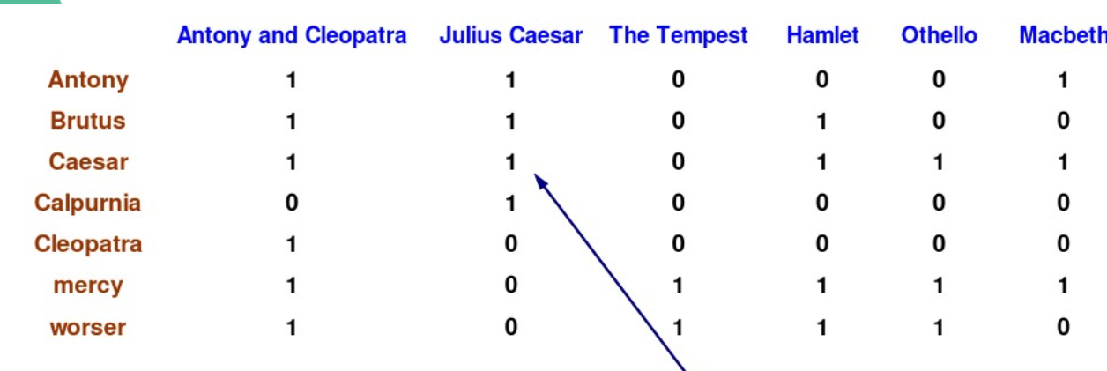

Slide 5
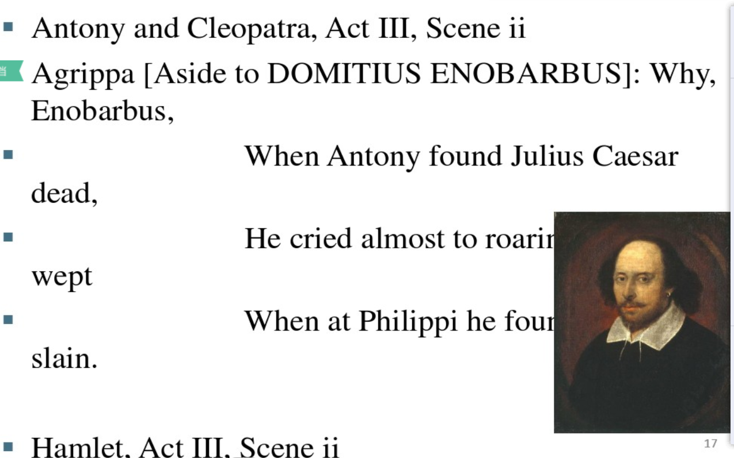

Slide 6
Bool Retrieval
Collection: a set of documents
target: return the documents according to the user's requirement
The above matrix is a sparse matrix
Then how to store the relation between the word and the document?

Slide 7
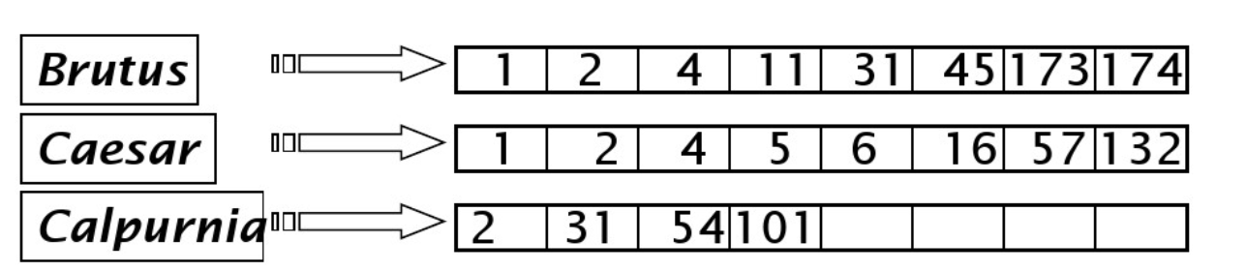
Index--Inverted Index
for each word item t, record the list of documents which contain t
for each document, we give it a unique ID, docID
Then, whether we can use a fixed length array to store docID?
If we want to insert caesar into document 14, how to do it?

Slide 8
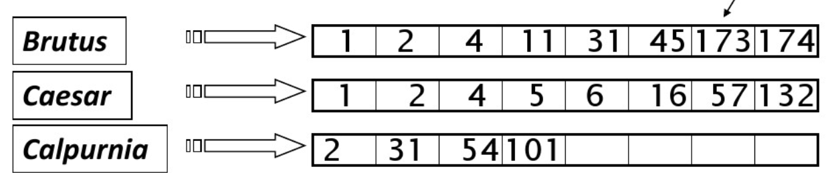
Index--Inverted Index
Then, we should use variable array or linked list to solve the above problem

Slide 9
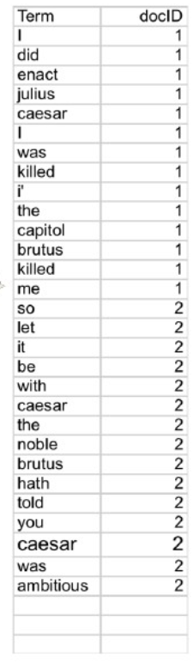
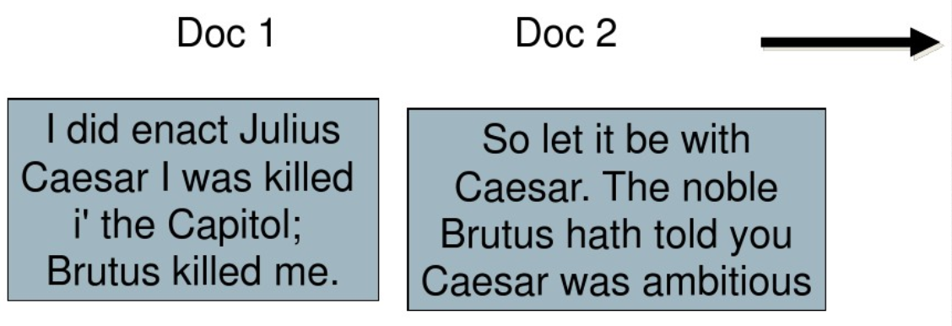
Index--Inverted Index
Then, we can have the tuple: <word item, docID>

Slide 10
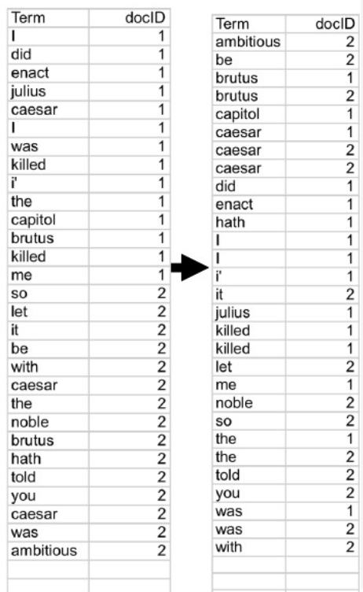
Index--Inverted Index
Then, we can reorder the list according to the docID

Slide 11
Index--Inverted Index
Then, we can reorder the list according to the docID

Slide 12
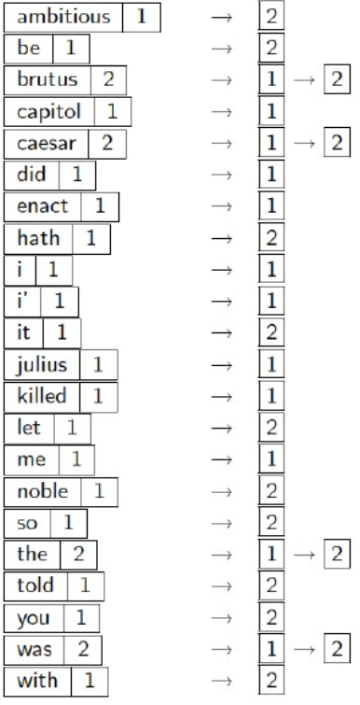
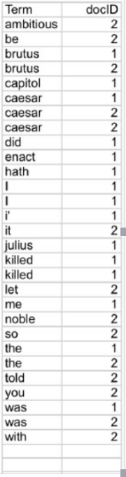
Index--Inverted Index
notice that each word item may appear in different documents
then, we introduce frequency to record this.

Slide 13
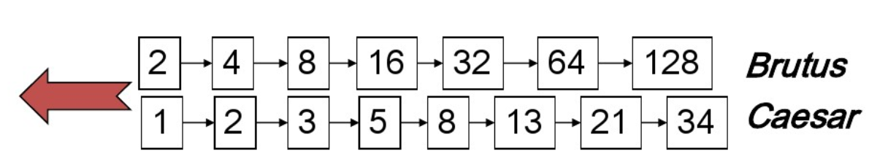
How to use Inverted Index in Bool Retrieval
Brutus AND Caesar
locate Brutus in the list and return the inverted index
locate Caesar in the list and return the inverted index
Merge together to compute intersection

Slide 14
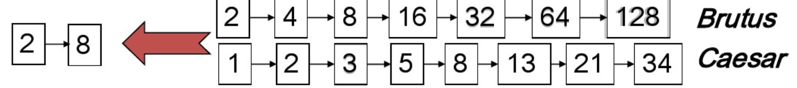
How to use Inverted Index in Bool Retrieval
Just use algorithm mentioned in Data Structure
Time complexity O(X+Y)
Why? The document ID is in sequence.

Slide 15
How to use Inverted Index in Bool Retrieval
OR? Brutus OR Caesar
NOT? Brutus AND NOT Caesar

Slide 16
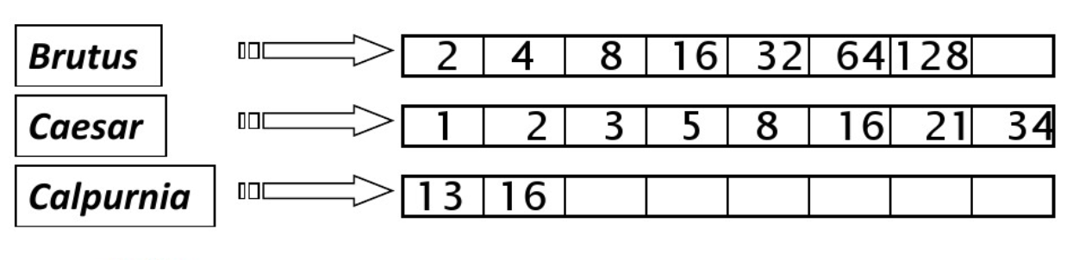
How to use Inverted Index in Bool Retrieval
whether the disposing sequence can influence the efficiency?
consider the AND for n word item?
for each word item, get the inverted index and merge
Brutus AND Caesar AND Calpurnia

Slide 17
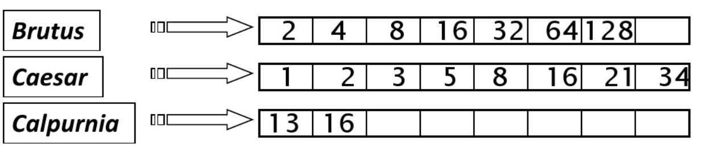
How to use Inverted Index in Bool Retrieval
Brutus AND Caesar AND Calpurnia
Dispose from small to big

Slide 18
Bool Retrieval
Query the news related to 2015-2017 best chinese voice winners, how to use bool retrieval to express?
(2015 OR 2016 OR 2017) AND ( (best chinese voice) or (Chinese voice) or (Chinese new voice) or (new voice) or (best voice)) AND (winners)
complex expression
if too strict, some useful results will be filtered out; if too relax, some useless results will be included
cannot be used by end users
cannot rank the result

